Slide 1

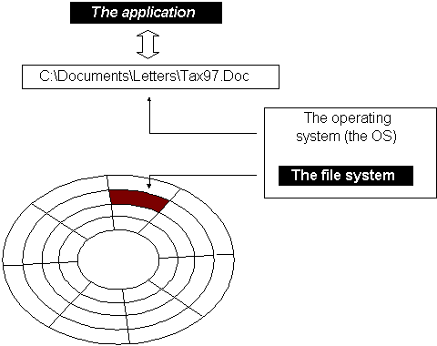
File System Forensic Analysis
Notes:
In the last lecture, we have learned how to conduct disk volume analysis. As you already known, hard disk, the most popular data storage device, is usually divided into several partitions. So we need to conduct disk volume analysis and figure out the layout of the disk. For example, we can investigate an important data structure, partition table, in the MBR to locate these partitions. What is inside these partitions? This will be our next important topic.

Slide 2


Evidence Acquisition
Data structures
Analysis Techniques
Law, Ethics and Legal Issues
Notes:
Let’s take a look what we already learned. We already learned how to acquire data or evidence. Also, we have started to understand these acquired data or evidence. For example, we figure out how data are organized on a disk, particularly, looking at the partition table in the MBR to figure out the layout of the disk and identify the locations of the partitions. Also, we can look at some simple disk volume analysis techniques, like Partition Consistency Checks.
Then,, we can go further to use different techniques to analyze these data stored in each partition.
Starting from now, we will learn more data structures and forensics analysis techniques.

Slide 3



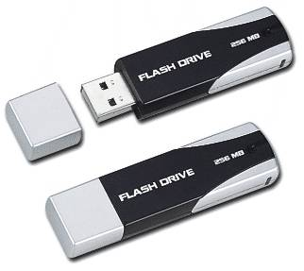
File Systems
Partitions
digital storage devices
Notes:
The hard disk, the most popular data storage device, is usually divided into several partitions. But what is inside these partitions or volumes?
[click]
Most likely, a partition contains a file system. So, next we need to conduct a file system analysis. Therefore, we need to understand how files are organized in a partition formatted with a file system.

Slide 4
Dose of Reality:
We have witnessed Cyber attack and Computer abuse!
Cyberattacks and computer abuse (the use of a computer for improper or illegal activities) will change the system, leaving a forensic “footprint” within the file system.
Digital Evidence
Notes:
Why we need to analyze these file systems, or file system forensics.
We're under attack, and also have witnessed lots of computer abuse.
Cyberattacks and the use of a computer for improper or illegal activities (computer abuse) will change the system, leaving a forensic “footprint” within the file system.
For example, when a file is accessed or modified, the timestamps for the file is changed. Or a file is deleted, file system actions on files (deletions, particularly) do not completely delete a file, and there is a period of time where they are forensically still “available”. Therefore, the deleted file can be recovered.
So analyzing file system is very important since it provides the investigator with a wealth of information about what happened to the target system.

Slide 5



Dose of Reality:
Where is his patient record?
Last name, First name
Walk-in Clinic
I don’t feel good!
Notes:
Before I discuss fille system forensic analysis in more detail, I would like to talk about something you are very familiar with.
When you don’t feel well, you go to a walk-in clinic or see your family doctor.
It is very important for the doctor to know your medical history.
[click]
So the nurse receptionist will usually ask for your names.
[click]
Then, the nurse can find your patient record quickly. This is because the patient records are organized alphabetically.

Slide 6


Disk Block Allocation for files
How do we allocate files on disk so that
we can easily gain access to files
space is utilized effectively
allow accesses that are
Random/Direct: each block can be accessed independently of other
Quick - try to minimize seek time
Notes:
Similar to patient record management in a clinic, we are now talking about how files are organized. From the perspective of a file system, we need to make sure that we allocate files on disk in a way
So we can easily gain access to files
Also, disk space is utilized effectively. Also, the file system should support random and direct access to a disk space. In other words, each disk block can be accessed independently of other.

Slide 7
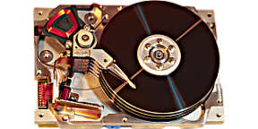


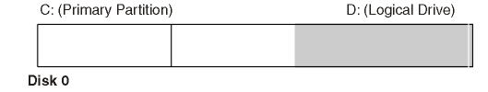
Dose of Reality:
I want to find a file, named cv.pdf
Physical Disk Address
(Cylinder-Head-Sector)
Notes:
We already know that a disk is usually divided into several partitions.
[click]
However, in real world today, we want to find a file based on its name. There is still a huge gap between volumes (or partitions) and file name.

Slide 8

Disk Block Allocation for files
How do we allocate files on disk so that
we can easily gain access to files
space is utilized effectively
allow accesses that are
Random/Direct: each block can be accessed independently of other
Quick - try to minimize seek time
Having Only Volume System Is Not Enough!
A volume (or partition) must be formatted with a file system , before it can accept files to be saved!
Notes:
Having Only Volume System Is Not Enough!
[click]
A volume (or partition) must be formatted with a file system , before it can accept files to be saved!
It is worth noting that it is not accurate that we format a disk, though we always say it. In reality, we format a partition.

Slide 9
File System
A file system (or filesystem) is a method for storing and organizing computer files and the data they contain to make it easy to find and access them.
How files are organized?
[1] File system. http://en.wikipedia.org/wiki/File_system
Notes:
What is a file system? A file system (or filesystem) is a method for storing and organizing computer files and the data they contain to make it easy to find and access them. In other words, file system refers to how files are organized?
In order to conduct fille system forensic analysis, we must know how a file system is implemented.

Slide 10
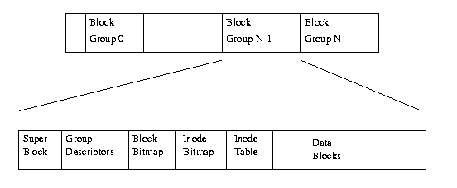
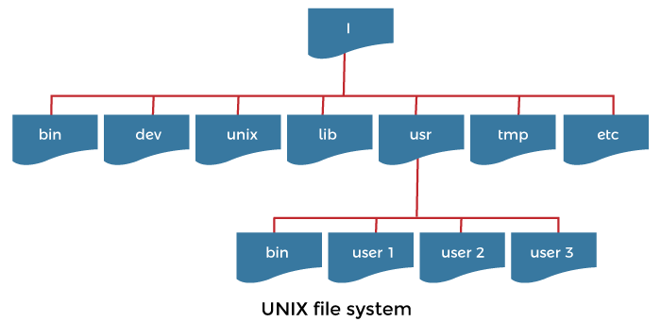
File System (cont’d)
Our view
Physical Layout on the partition of a File system
Structure of a file system (e.g., The Second Extended File system (EXT2))
User view
hierarchical structure of files and directories
Partitioning
Notes:
From the computer science’s perspective, a file system can be treated as a bunch of data structures used to organize files.
For example, in UNIX (using ext file system), the file system is a hierarchical structure of files and directories where users can store and retrieve information using the files. So we have to know how they are organized in a formatted partition.

Slide 11
File System (cont’d)
Filesystem data structures
An example of EXT2
Our view
Physical Layout on the partition of a File system
User data
User view
hierarchical structure of files and directories
[1] https://tldp.org/LDP/tlk/fs/filesystem.html
Notes:
In summary, data in a file system can be simply divided into two major categories:
Data structures used to manage user files, and user data stored in files.

Slide 12





File System (cont’d)
How files are organized?
Notes:
How files are organized? There are many file systems today. Their designs are different. Some are well deigned.

Slide 13



File System (cont’d)
How files are organized?
Where is my book?
Notes:
Some are not. For example, can you find a book in these rooms?

Slide 14
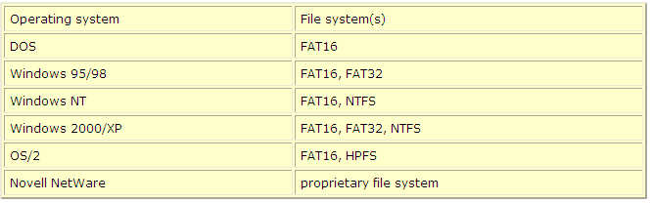
File systems and Operating Systems
[1] An illustrated Guide to the File Systems.
http://www.karbosguide.com/hardware/module6a1.htm
Notes:
Next, let’s take a look at the relationship between File systems and Operating Systems.
There are many Operating Systems and File systems.
Also, an Operating System can support multiple File systems. For example, by default, Windows 2000/XP supports FAT and NTFS.

Slide 15


File systems and Operating Systems (cont’d)
stored
(e.g., FAT, NTFS)
[1] An illustrated Guide to the File Systems.
http://www.karbosguide.com/hardware/module6a1.htm
Notes:
The file system is actually the interface between operating system and drives. When the user software, such as MS Word, asks to read a file from the hard disk, the operating system (Windows 95/98 or NT) asks the file system (FAT or NTFS) to open the file:
The file system knows where files are saved. It finds and reads the relevant sectors and delivers the data to the operating system.

Slide 16
Disk Allocation Methods
Notes:
In order to conduct fille system forensic analysis, we must know how a file system is implemented.
So we need to know how the files are allocated with disk space and stored in the disk blocks.

Slide 17

Three Kinds of File Allocation
Contiguous Allocation
Linked Allocation
Indexed Allocation
Many Disk Allocation Methods
[1] File Allocation Methods
https://www.geeksforgeeks.org/file-allocation-methods/
Notes:
There are three main disk space or file allocation methods.
Contiguous Allocation, Linked Allocation and Indexed Allocation.
The main idea behind these methods is to provide:
Efficient disk space utilization.
Fast access to the file blocks.
All the three methods have their own advantages and disadvantages

Slide 18
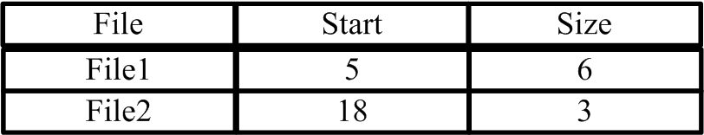
Contiguous Allocation
……
File is stored in contiguous blocks on disk
File descriptor: first block address, file size
5
……
18
Any problem?
……
Structural data
User data
Notes:
In Contiguous Allocation, each file occupies a contiguous set of blocks on the disk.
This means that given the starting block address and the length of the file (in terms of blocks required), we can determine the blocks occupied by the file.
The directory entry for a file with contiguous allocation contains
file name
address of the first block
length in blocks
In the examples here, the file ‘File2’ starts from the block 18 with length = 3 blocks. Therefore, it occupies 18, 19, 20 blocks.
[click]
What is the problem with Contiguous Allocation?
Increasing file size is difficult because it depends on the availability of contiguous disk space at a particular instance. For example, what if you increase the size of File1 which now needs 20 blocks. Now, we have a problem since starting from block 18, these disk space is already occupied by File2.

Slide 19

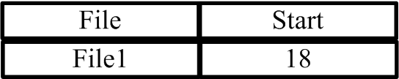
Linked Allocation - File Allocation Table (FAT)
……
Each block contains disk address of next file block
File descriptor: first block address
12
15
18
*File1: Size 3 blocks; Blocks 18, 20, 15
20
……
Structural data
User data
Notes:
In linked allocation (or Linked List Allocation), each file is a linked list of disk blocks. The popular example of linked allocation is File Allocation Table (FAT), which will be detailed later.
Note that these disk blocks need not be contiguous. The disk blocks can be scattered anywhere on the disk.
The directory entry contains a pointer to the starting. Each block contains a pointer to the next block occupied by the file.
The ending file block contains a special flag indicating that this is the last block for the file.
The file ‘file1’ in following here shows how the blocks are randomly distributed. The last block (15) contains a special flag indicating that this is the last block for the file and does not point to any other block.
Disadvantage is that it does not support random or direct access. We can not directly access the blocks of a file. A block k of a file can be accessed by traversing k blocks sequentially (sequential access ) from the starting block of the file via block pointers.
It is very slow when reading a large file.

Slide 20
Indexed Allocation
……
File Index is an array containing addresses of 1_{st}, 2_{nd}, etc block of file
File descriptor: index
12
15
*File1: Size 3 blocks; Blocks 18, 20, 15
18
Problem: size of the index?
20
……
Structural data
User data
Notes:
In Indexed Allocation, there is a File Index for each file. It is an array containing addresses of the disk blocks occupied by the file.
The File Index is usually contained in a special disk block known as the Index block.
The file ‘File1’ in the example here shows it occupies blocks 18, 20, 15.
Disadvantages is we may not know size of the index in advance. Also, the pointer overhead for indexed allocation is a waste.

Slide 21
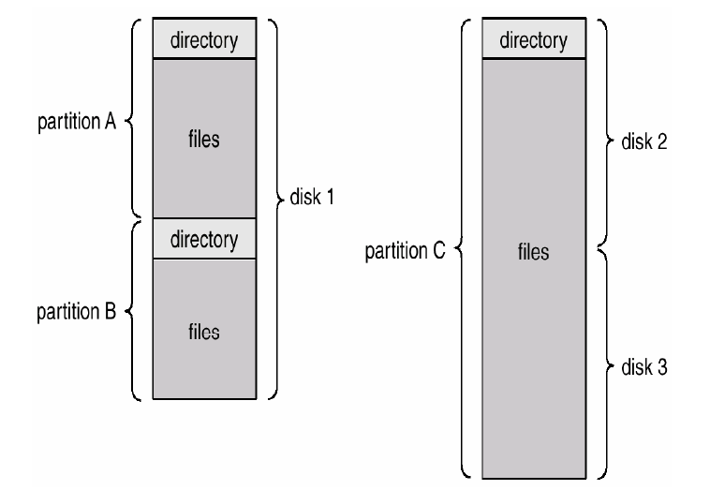
Organizing File System
Disks are split into one or more partitions (or minidisks).
Each partition contains information about files (directory) within it.
[1] Silberschatz, Galvin, and Gagne "Operating System Concepts: 6th Edition,"
John Wiley & Sons, 2002.
Notes:
As mentioned, disks are split into one or more partitions (or minidisks).
Each partition is formatted with a file system.
A file system organizes files into different folders, particularly in a hierarchical folder structure.

Slide 22
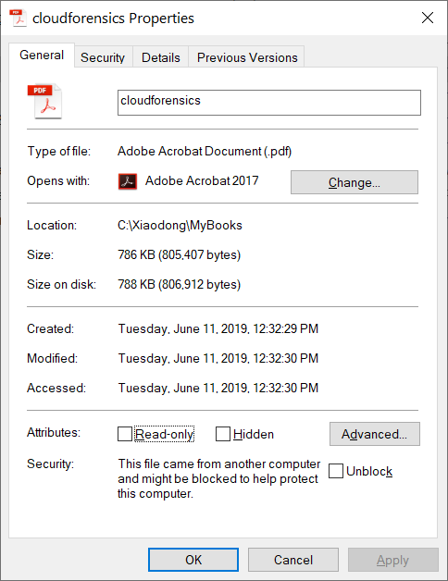
Essential and Nonessential Data
Essential for finding a file: File name, size, and address
Not essential for finding a file but data is there for convenience : access time and security permissions
Name:
cv.txt
Cluster:
888
Size:
12
Last access:
September 10, 2009
Cluster 887
Cluster 888
James lives in Kingston,
ON, Canada.
David lives in Toronto,
ON, Canada.
Notes:
A file has many properties, which can be mainly divided into two categories:
Essential for finding a file: File name, size, and address
Not essential for finding a file but data is there for convenience : access time and security permissions

Slide 23
Data Categories
Filesystem data structures
An example of EXT2
Our view
Physical Layout on the partition of a File system
User data
User view
hierarchical structure of files and directories
Notes:
Recall that data in a file system can be simply divided into two major categories:
Data structures used to manage user files, and user data stored in files.

Slide 24

Data Categories (cont’d)
In order to understand different analysis techniques, we divide the data in file systems into several categories.
File System
Content
Metadata
File Name
Application
All data in a file system belong to one of the categories based on the role they play in the file system.
Notes:
The data in file systems can be further divided into five categories, including
File System data
File Content
Metadata
File Name data
Application data
All data in a file system belong to one of the categories based on the role they play in the file system.

Slide 25
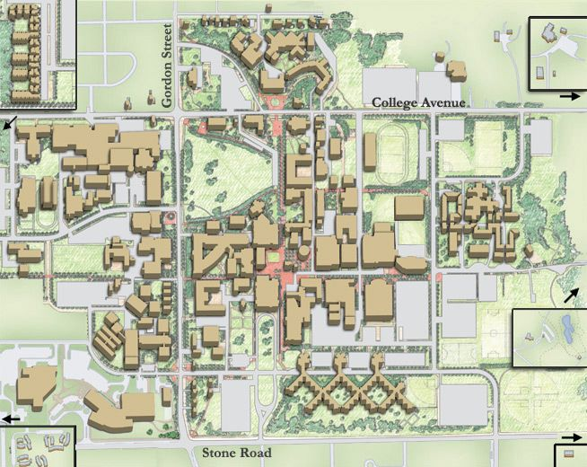

Data Categories (cont’d)
Reynolds Building
File System: General file system information
Location of data structures, data unit sizes
a map for this specific file system
Content: The data itself
This category is made up of the actual content of a file. Most of the information in a file system is made up of this data category. It is typically organized into data units (allocation units or standard-size container), aka clusters or blocks.
Notes:
File System data refers to General file system information. It includes the location of data structures used in the file system, data unit sizes.
It is a map for this specific file system.
It s analogous to a map for the purpose of navigation in an unfamiliar place.
The second category, Content is the file data itself
This category is made up of the actual content of a file. Most of the information in a file system is made up of this data category. It is typically organized into data units or allocation units in the context of file system, aka clusters or blocks.

Slide 26

Data Categories (cont’d)
Metadata: Data that describes files, such as:
Location of file content
Size of the file
Creation time
Modification time
Access control information
Examples of data structures in this category include FAT directory entries, NTFS Master File Table (MFT) entries, and Ext3 inode structures.
This category does not contain the content of the file and the name of the file.
Notes:
The next one is Metadata, is the data that describes files, such as:
Location of file content
Size of the file
Some important timestamps such as creation time, modification time
Access control information or permissions on a file
Examples of data structures in this category include FAT directory entries, NTFS Master File Table (MFT) entries, and Ext3 inode structures.
Note that this category does not contain the content of the file and the name of the file.

Slide 27
Data Categories (cont’d)
File Name or human interface: The name of the file
Name of file
Similar to a host name in a network
Application: Data that provides special features
These data are not necessary for normal reading and writing of data. Instead, they provide features such as
user quota information: disk quotas can be configured for individual users to limit their disk space usage to avoid that a user consumes too much disk space.
file system journals: the journal is a special file that logs the changes destined for the file system.
These data can be more easily forged than other data.
Notes:
Next is File Name or human interface, which refers to the name of the file
In cyber world, it is similar to a host name in a network.
The final category is application data, which provides special features.
Please note that these data are not necessary for normal reading and writing of data.
Instead, they provide features such as user quota information and file system journals.
For example, in a modern OS, disk quotas can be configured for individual users to limit their disk space usage to avoid that a user consumes too much disk space.
Also, the journal is a special file that logs the changes destined for the file system.
However, please be advised that these data can be more easily forged than other data.

Slide 28
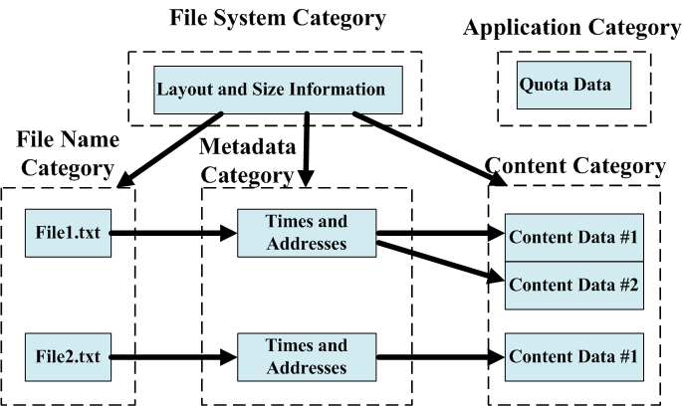
Interaction between the five data categories
Notes:
Next, let’s take a look at the relationship among these five data categories.
When you want to access a file, we first take a look at File System data to figure out the
layout of a file system, particularly determining where File Name, Metadata, and Content data
are stored.
Then, you can search the file system based on a file name and find the corresponding metadata which is used to describe the file, including the
addresses of the clusters/blocks that store the file contents.
Remember that these addresses will be logical addresses or file system addresses.
So once they are discovered, we need to determine the physical disk location of these clusters/blocks. The translation from the addresses of the
clusters/blocks to physical addresses is done automatically by the file system.
Once these physical addresses are acquired, these blocks can be accessed directly to obtain the actual file contents.
Also, there is application data, which provides special features such as user quota information and file system journals. However, not all file systems have application data, but modern file systems are journaling file systems.

Slide 29

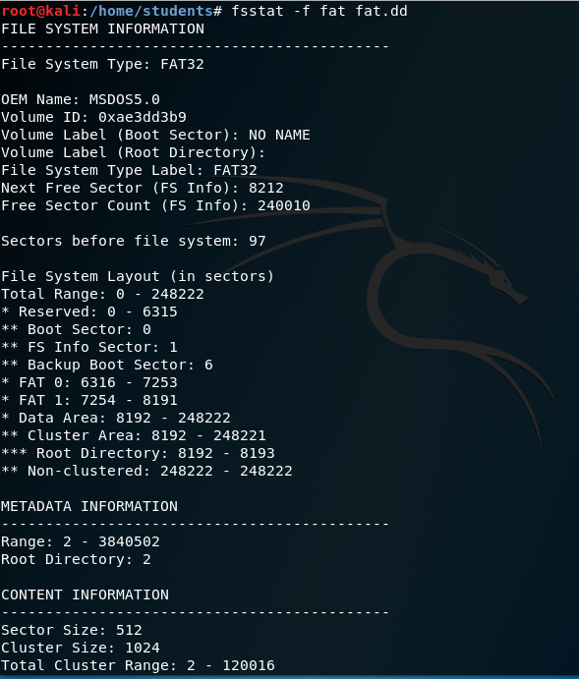
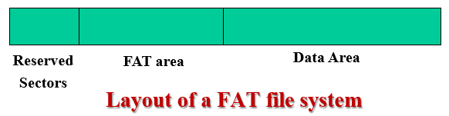
Reserved Sectors
FAT area
Data area
Notes:
In TSK, a utility called fsstat is provided to display the details associated with a file system.
This is an example output of the fsstat tool for a FAT file system. Note that the output of this tool is file system specific.

Slide 30
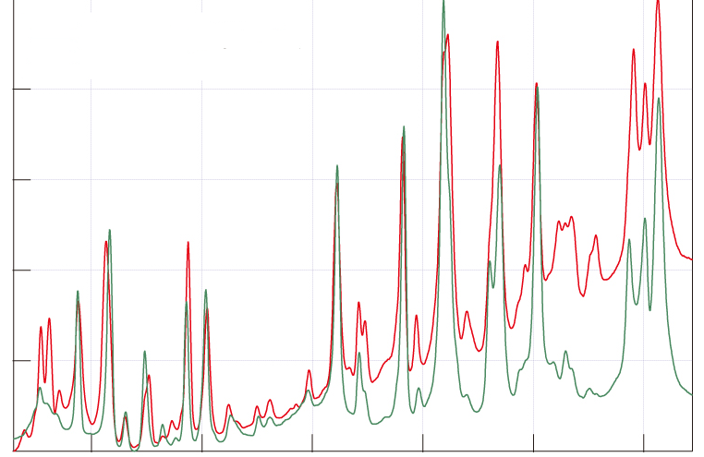
File System Analysis Techniques
Notes:
Next, we will study some popular file system analysis techniques.

Slide 31


File System Category
Notes:
We will first look at some analysis techniques of file System data. Always the first step into analyzing a file system.

Slide 32
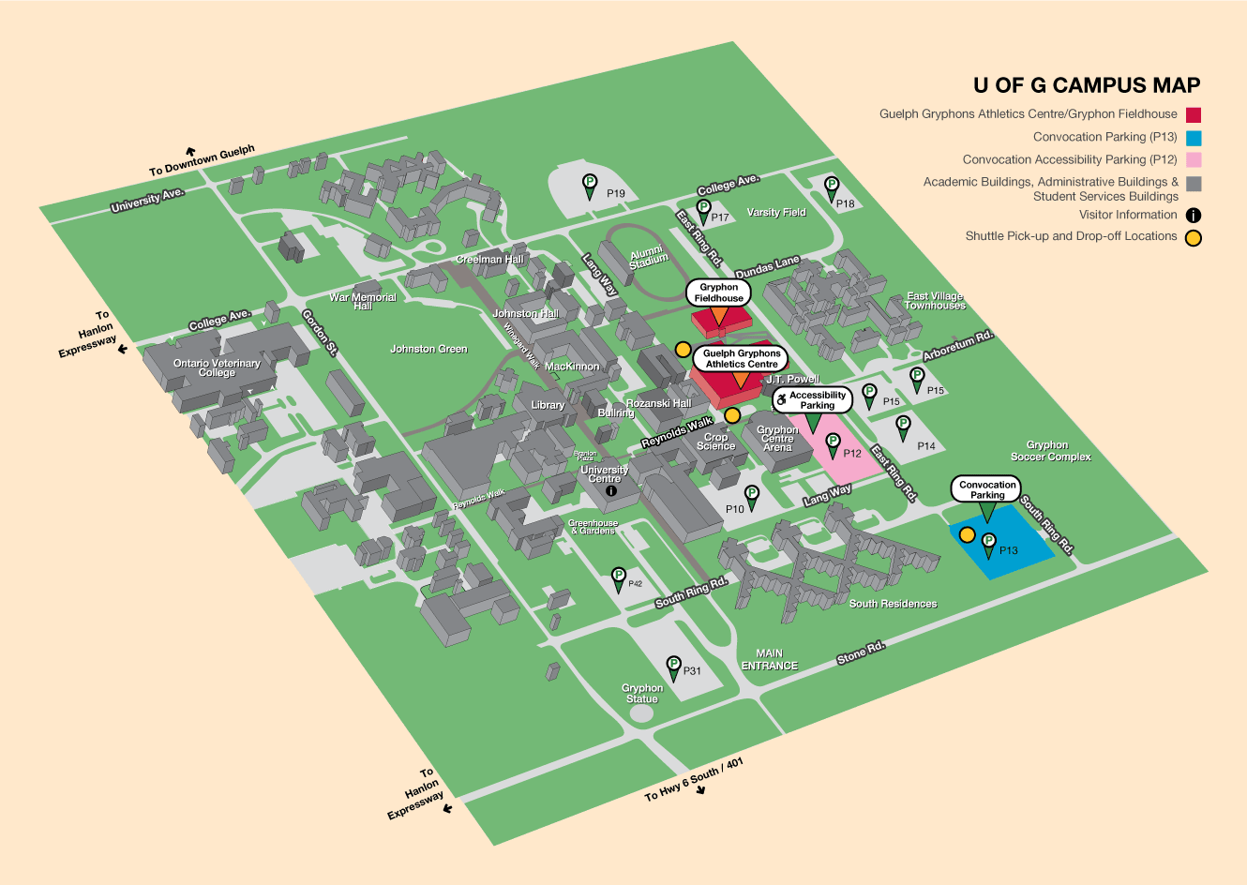
File System Data Analysis Techniques
Analysis of data in the file system category is required for all types of file system analysis.
Analysis of this category shows
general layout information
or the version of file system,
or the application that created the file system
or the creation date, and the file system label.
First sector of the file system, and data structure is standard
“Campus map” for a file system
Notes:
Analysis of data in the file system category is required for all types of file system analysis.
This is because file system data is a map for a specific file system. It includes the location of data structures used in the file system.
It is usually located in the first sector of the file system, and data structure for a specific file system is standard.

Slide 33
File System Data Analysis Techniques (cont’d)
Consistency check
The size of the file system = the size of the volume in which it is located?
If the partition (volume) is larger, the sectors after the file system are called volume slack and could be used to hide data.
Partition
File system volume
Notes:
So the Consistency check must be done. For example, a question must be answered: Is the size of the file system equal to the size of the volume in which it is located?
Be default, when formatting a partition, the new filesystem volume takes up the entire partition.
If the partition (volume) is larger, the sectors after the file system are called volume slack and could be used to hide data.

Slide 34

Content Category
Notes:
We next look at some analysis techniques of file content data.

Slide 35
File Content Analysis Techniques
Analysis of the content category is conducted to
recover deleted data
conduct low-level searches.
For example, look for politically sensitive content (e.g., "democracy", "freedom", "opposition"), content related to violence and terrorism (e.g., "torture", "terror", "explosive"),
Notes:
The most popular analysis techniques for file content are to
recover deleted data
conduct searches for specific keywords in a file

Slide 36
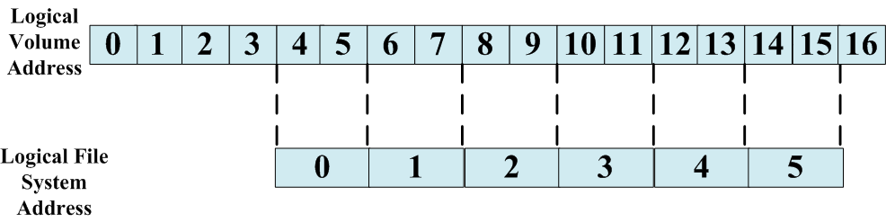

File Content Analysis Techniques (cont’d)
Logical File System Address
A sector can have multiple addresses
Physical: Address relative to the start of the drive
Logical: Address relative to the start of the volume
File systems use the Logical volume address, and also group sectors into clusters or blocks and assign them addresses.
Cluster 0
An example volume where the file system has assigned addresses to sectors in groups of two and has not assigned addresses to some sectors.
Notes:
We already know that we use a sector address to uniquely locate a sector on hard disk, for example Logical block addressing (LBA) address, linearly addressing sector addresses, such as Sector 0, 1, …
It is also known as physical address.
However, a sector can have multiple addresses, including Physical address, which is address relative to the start of the drive, and logical addresses, which is address relative to the start of the volume.
File systems use the Logical volume address, but also group sectors into data units or allocation units, aka clusters or blocks, and assign them addresses.
[click]
Please note that not all the disk space occupied by a file system has file system addresses (Cluster or block addresses)
Cluster addresses may not start with 0. For example, In FAT file system, Cluster addresses may not start with 2.

Slide 37

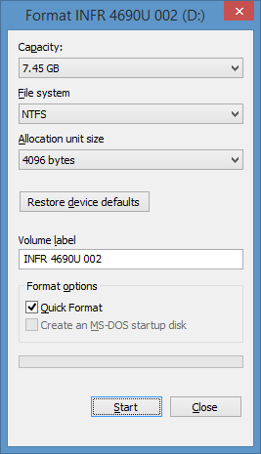
File Content Analysis Techniques (cont’d)
File systems of Windows (e.g., NTFS or FAT)
File systems of Unix-like operating systems (e.g., Ext2, Ext3)
Cluster
Block
Notes:
File systems group sectors into data units or allocation units, aka clusters or blocks. Therefore, you need to know the cluster size.
Remember when you format a USB drive (a partition) with a file system (which is NTFS in the example here), you need to specify one parameter, allocation unit.

Slide 38
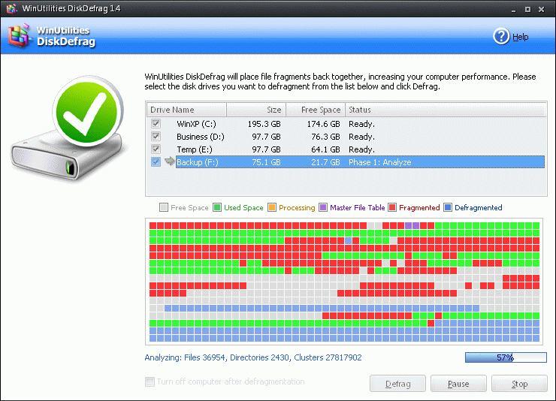
File Content Analysis Techniques (cont’d)
Allocation Strategies
File system fragmentation, sometimes called file system aging, is the inability of a file system to lay out related data sequentially (contiguously). As a result, the files are scattered across the hard disk drive in pieces.
Allocation Strategies
First available strategy
Next available strategy
Best fit strategy
Disk Defragmenter
[1] File system fragmentation.
http://en.wikipedia.org/wiki/File_system_fragmentation
Notes:
In order to analyze the file data, you will need to understand how a file system allocates disk space to files. There are three main allocation Strategies
First available strategy, Next available strategy, and Best fit strategy.
As files are created, deleted, and modified over time, their size and physical location on the hard disk will change.
As a result, file fragmentation becomes inevitable, and a file is scattered throughout a hard disk instead of one continuous location. It is also called file system aging, so slowing down your computer.
Therefore, you may have to improve your computer's performance by performing disk defragmentation.

Slide 39
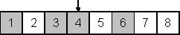
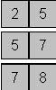
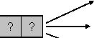
Allocation Strategies (cont’d)
Last Allocated
Current allocation status of 8 data units
Unallocated Allocated
First available
Next available strategy
Best fit strategy
Allocating two more data units
Notes:
Next, let us take a look at an example of allocating two more data units to a file. The top figure shows the current allocation status of 8 data units available to the file.
If we are using First available strategy, data units 2 and 5 will be chosen. This is because for First available strategy, the file system searches for free space at the beginning of the file system until the disk space large enough for required data is found and then allocated to the file. In the example here, data units 2 and 5 are selected.
If we are using Next available strategy, data units 5 and 7 will be chosen. This is because for Next available strategy, it also uses the same principle as first available of allocating the next free space being large enough to hold the data, but the search is done from the current position in the file system or the last allocated data unit, which is data unit 4 in the example.
If we are using Best fit strategy, data units 7 and 8 will be chosen. This is because for Best fit strategy, the file system searches one single contiguous disk space starting from the beginning of the file system.
Please note that the allocation strategy used in a file system has a huge impact on almost all aspects of digital forensics, because it determines where data is placed on storage media. Unfortunately, disk space allocation behavior in different OS and file systems are not publicly specified or documented.

Slide 40
File Content Analysis Techniques (cont’d)
- Bad Sector Analysis
A bad sector is a sector on the disk which data cannot be written or read due to a physical damage or inconsistencies of parity checking bits on disk. Any data that is written or stored on that area is likely to be lost or corrupted.
A bad sector cannot be repaired, but it can be marked as unusable.
Once marked as unusable, the Operating System will know not to attempt to store data in that bad sector. The storage capacity of the disk will be decreased by the amount of storage space in the bad sector.
To check your drive for bad sectors, and mark them as such: Run a chkdsk on the drive in Windows XP.
Notes:
After a hard disk is used for a while, it is very common that some area of the disk is permanently damaged, aka bad sector.
A bad sector is a sector on the disk which data cannot be written or read.
A bad sector cannot be repaired, but it can be marked as unusable.
Once marked as unusable, the Operating System will know not to attempt to store data in that bad sector.
For example, you can run a chkdsk on the drive in Windows to check your disk for bad sectors, and mark them accordingly.

Slide 41
File Content Analysis Techniques (cont’d)
- Bad Sector Analysis
Hard drives are mechanical devices and all mechanical devices will eventually fail. back up your hard drive on a regular basis.
It is easy to hide data using the file system functionality, if it exists.
Many consistency-checking tools will not verify a data unit that the file system reports as being damaged is actually damaged.
A user could manually add a data unit to the damaged list and place data in it.
Notes:
While it is very normal to see bad sectors on a disk. However, you also need to be aware that it is easy to hide data into some good sectors but labelled bad sectors.
Note that a user could manually add a data unit to the damaged list and place data in it.

Slide 42
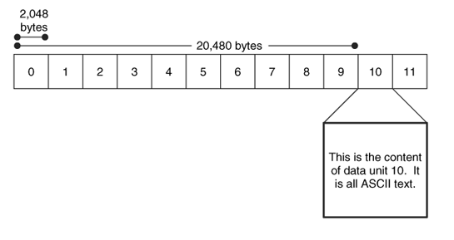
File Content Analysis Techniques (cont’d)
- Data Unit Viewing
The investigator knows the address of evidence
Graphical representation where we view the contents of data unit 10.
Notes:
Another common analysis technique for file content is Data Unit Viewing.
In this case, the investigator knows the address of evidence. So the investigator uses some tool to view the content of a data unit which is of interest to the investigator.

Slide 43
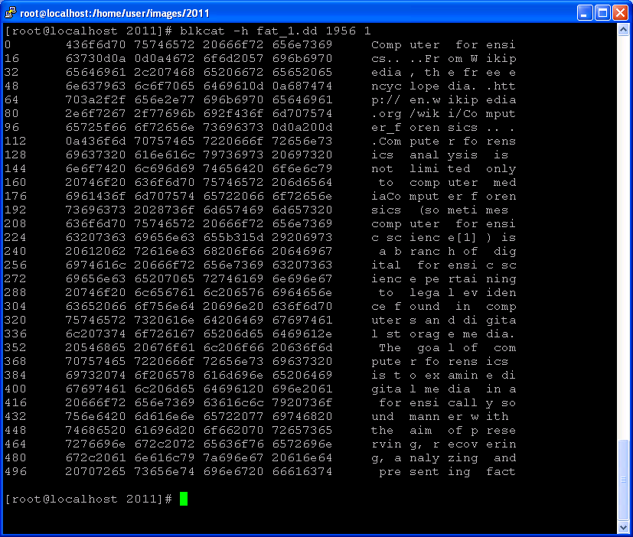
File Content Analysis Techniques (cont’d)
- Data Unit Viewing
blkcat - Display the content of a data unit in a file system.
Notes:
This is an example output of the TSK utility, blkcat, which displays the content of a data unit in a file system volume.

Slide 44
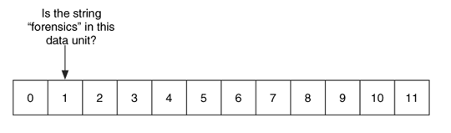
File Content Analysis Techniques (cont’d)
- Keyword Searching
What if we only know a keyword or value? Don’t know where it is.
Looks in each data unit for a known keyword or value.
Notes:
What if we only know a keyword or value? Don’t know where it is. So we are talking about another analysis technique for file content is Keyword Searching, for example, keyword search. Specifically, it looks in each data unit for a known keyword or value. After knowing the address of the data unit which contains the keyword.
Then, we can use Data Unit Viewing, for example, using the TSK utility, blkcat.

Slide 45
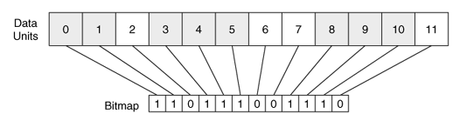
File Content Analysis Techniques (cont’d)
- Data Unit Allocation Status
To extract the unallocated data units, we examine the allocation bitmap and extract the unallocated data units
Notes:
In a digital investigation, sometimes we are more interested in unallocated disk space, which contains deleted files or hidden data. In a file system, the allocation bitmap is used to indicate whether data units are occupied by or allocated to a file. Specifically, one bit in the allocation bitmap stands for the allocation status of one particular data unit.
So to extract the unallocated data units, we examine the allocation bitmap and extract the unallocated data units, for example, these having a given keyword or value.

Slide 46



File Content Analysis Techniques (cont’d)
- Data Unit Allocation Status
To extract the unallocated data units, we examine the allocation bitmap and extract the unallocated data units
The Data Unit Allocation Status technique shows all the unallocated data units to find hidden or ‘deleted’ data.
Notes:
After extracting the unallocated data units, we can search for deleted files or hidden data.

Slide 47

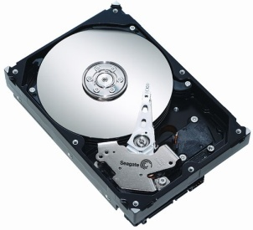
File Content Analysis Techniques (cont’d)
- Data Unit Allocation Status
search for a known keyword or value in each data unit
Unallocated data
Hard disk image
Recover data/file
Notes:
Typically, we acquire the image of a disk used by the suspect. Then, we extract the unallocated data units.
What is inside?
[click]
It could contain deleted files or hidden data.
[click]
So we can search for a known keyword or value in each data unit
[click]
Or recover deleted files.

Slide 48
File Content Analysis Techniques (cont’d)
- Data Unit Allocation Status
Converts between unallocated disk unit numbers and regular disk unit numbers
To extract the unallocated data units
0
1
2
3
2
6
7
11
Find a suspicious data
Notes:
Now we have a problem that we need to solve.
Suppose we find some suspicious data in an extracted unallocated data unit, for example, the second unallocated data unit in the example. However, we must also know which data unit it is in the file system when conducting further investigation.
[click]
So we need to know how to convert between unallocated disk unit numbers and regular disk unit numbers.

Slide 49
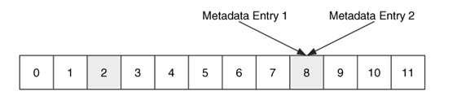
File Content Analysis Techniques (cont’d)
- Consistency Checks
The Consistency Check technique allows you to determine if the file system is in a suspicious state. For example, a consistency check should verify
Orphan data units (allocated data units that do not have a corresponding metadata structure) and be found in this manner.
all data units have one and only one metadata entry pointing to them.
Notes:
Similar to volume analysis, it is very important to do a consistency check. It allows you to determine if the file system is in a suspicious state. For example, a consistency check should verify
Orphan data units: it refers to allocated data units that do not have a corresponding metadata structure or is occupied by any file.
In a regular situation, all data units have one and only one metadata entry pointing to them. But what if you see some data unit having more than one metadata entry point to it. In the example here, there are two metadata entries pointing to Data unit 8.
If a consistency check shows an abnormality, a further investigation is needed.
For example, orphan data unit must be examined because it could be used to hide data.

Slide 50

File Content Analysis Techniques (cont’d)
- Consistency Checks
Another check examines each of the data units that are listed as damaged. Any data unit that is in the damaged list should have zeros in it. Any non-zero data should be examined because it could be data that was hidden by the user.
Damaged
may not be damaged
Notes:
As mentioned before, a bad sector may not be damaged. As such, another consistency check is to examine bad sectors or damaged data units because they could be used to hide data.

Slide 51
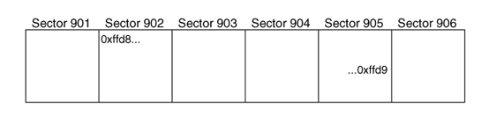

File Content Analysis Techniques (cont’d)
- File Carving
Data Carving or File Carving
Blocks of raw data that can be carved to find a JPEG picture in sectors 902 to 905.
Notes:
Some file analysis techniques are independent from any file system.
For example, in some cases, when a file is deleted, and the file system metadata information could also be gone.
In this case, we can not use metadata-based recovery techniques to recover these deleted files.
Instead, we need to recover the deleted file solely based on the remaining file content. This technology is called file carving or data carving.
In many cases, file carving could be very easy. This is because many file types have well-known values in an end of file (footer) or beginning of file (header). Also, many files are stored contiguously on hard disk, and are not broken apart.
For example, A JPEG file has a unique header starting with \xff\xd8 and a unique footer \xff\xd9.
If we find the header in hard disk sector 902, and the footer in hard disk sector 905, respectively. Blocks of raw data that can be carved to find a JPEG picture in sectors 902 to 905.
File type can also be used to organize the files in a file system. If the investigation is looking for a specific type of data, an investigator can sort the files based on their content structure. Note that many file types have unique content structure.

Slide 52
File Content Analysis Techniques (cont’d)
- File Type Sorting
File Type Sorting: File type can also be used to organize the files in a file system. If the investigation is looking for a specific type of data, an investigator can sort the files based on their content structure. Note that many file types have unique content structure.
Note that File Type Sorting can also be done using the file name extension.
However, it can be easily cheated.
Notes:
File type can also be used to organize the files in a file system. If the investigation is looking for a specific type of data, an investigator can sort the files based on their content structure. Note that many file types have unique content structure.

Slide 53

commonly used technique
Dose of Reality
It is very often that criminals try to hide their wrongdoings by deleting digital evidences.
When a file is deleted, it isn’t really erased – it continues existing on your hard drive, even after you empty it from the Recycle Bin.
Therefore, data recovery is one of the most common techniques in Digital Investigation.
To prevent others from recovering deleted data, wiping, or "secure delete," tools are used to wipe your hard drive’s free space – by writing other data over the free space on your hard drive, all deleted files will be erased.
Notes:
It is very often that criminals try to hide their wrongdoings by deleting digital evidences (e.g., downloaded illicit images or stolen confidential data or trade secret), which could indict them in the court.
However, when a file is deleted, it isn’t really erased – it continues existing on your hard drive, even after you empty it from the Recycle Bin.
Therefore, data recovery is one of the most common techniques in digital investigation.
To prevent others from recovering deleted data, wiping, or "secure delete," tools are used to wipe your hard drive’s free space – by writing other data over the free space on your hard drive, all deleted files will be erased.

Slide 54

File Content Analysis Techniques (cont’d)
- Wiping Techniques
Most wiping, or “secure delete”, tools operate in the content category and write zeros or random data to the data units that a file allocated or to all unused data units.
Wiping tools that are built into the OS are the most effective at wiping all data, but not the third-party applications frequently relying on the OS to act in a certain way.
Detection of wiping tools in this category can be difficult. Obviously, if all unallocated data units contain zeros or random values, you may suspect a wiping tool.
Application level evidence needed
Notes:
Therefore, besides data recovery, we also need to detect existence of wiping tools.
However, detection of wiping tools in this category can be difficult.
Luckily, most wiping, or "secure delete," tools operate in the content category and write zeros or random data to the data units that a file allocated or to all unused data units. Obviously, if all unallocated data units contain zeros or random values, you may suspect a wiping tool.
Also, we also look at application level evidence, and check if there is any evidence showing the installation of a wiping tool.

Slide 55
File Content Analysis Techniques (cont’d)
- Wiping Techniques
common methods/government, military and industry standards
U.S. Department of Defense's standard DoD 5220.22-M
Peter Gutmann's method
Random overwrite algorithm
From three different perspectives
Forensic investigator
Data privacy protection
Anti-forensics (sometimes counter forensics), e.g., criminals using anti-forensic methods
[1] Peter Gutmann. Secure Deletion of Data from Magnetic and Solid-State Memory.
https://www.cs.auckland.ac.nz/~pgut001/pubs/secure_del.html
Notes:
Regarding wiping techniques, there are common methods/government, military and industry standards. For example, the famous Peter Gutmann's method, which is developed by Peter Gutmann in 1996 and is one of several software-based data sanitization methods. Specifically, it suggests to overwrite existing information on a hard drive or another storage device using random characters up to 35 times.
However, we have to look at the wiping techniques from three different perspectives:
As forensic investigator, we look at the evidence showing the existence of a wiping tool in the suspect’s computer.
From data privacy protection aspect, we need to securely delete or remove the confidential data upon decommission of the storage device to ensure that the confidential data cannot be recovered.
Form anti-forensics aspect (sometimes counter forensics), e.g., criminals using anti-forensic methods to cover up their wrongdoings by deleting evidence, we must understand some popular anti-forensic methods. It is very similar to data privacy protection, but now with malicious intent.

Slide 56

How possible is it to recover deleted files? even after format, wiping, etc?
Notes:
Next, let us have a discussion on how possible is it to recover deleted files.
What if a hard disk is formted? Or the data is wiped out.
So the principe is very simple. These deleted files' data that has not been overwritten can be recovered.

Slide 57
How to hide data on a disk volume?
unpartitioned/unallocated space
volume slack
bad sectors (or data units)
Notes:
Next, let us work together to find some ways to hide data on a disk volume?
Some possible ways are
[click]
unpartitioned/unallocated space
[click]
volume slack
[click]
bad sectors (or data units)

Slide 58

Metadata Category
Notes:
We next look at some analysis techniques of Metadata.

Slide 59
Metadata Analysis Techniques
The metadata category includes the data that describe a file. Here you will find the data unit addresses that a file has allocated, the size of the file, and temporal information. The types of data in this category vary depending on the file system type.
There are four TSK tools in this category, and the names all start with i such as the istat command - Display details of a meta-data structure .
However, metadata isn’t generally visible unless you use a special tool, more skill is required to alter or otherwise manipulate it.
Notes:
Metadata describes files, including location of file content, size of the file, some important timestamps such as creation time, modification time, and access control information or permissions on a file.
There are four TSK tools in this category, and the names all start with i such as the istat command - Display details of a meta-data structure.
However, metadata isn't generally visible to regular users. You will need a special tool, and more skill is required to alter or otherwise manipulate it.

Slide 60
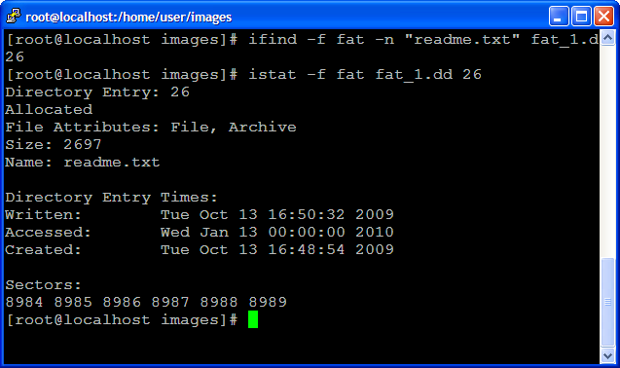
MAC Times
Notes:
This is an example output of the TSK utility, istat, which displays details of a meta-data structure. In the example here, istat displays the details of the meta-data structure 26 used by a file named readme.txt in a file system.
[click]
You may also notice that the metadata includes three timestamps including modification time (written), and accessed time and creation time. It is also known as MAC Times.

Slide 61
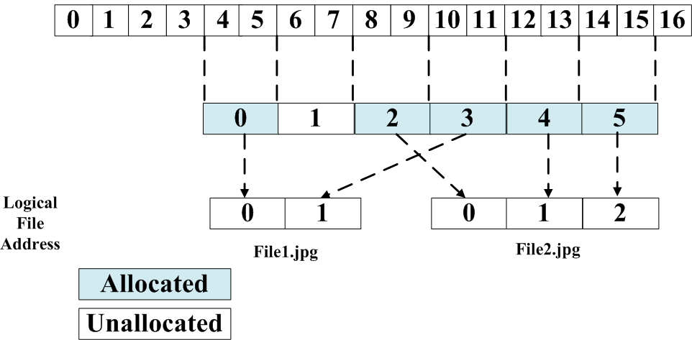
Metadata Analysis Techniques (cont’d)
Logical File Address
Sector 0
Logical File System Address
(Cluster number or address)
Cluster 0
Two files have allocated five data units, and logical file addresses have been assigned to the data units
Notes:
Now we need to introduce one more type of address, file address.
Each cluster allocated to a file is also assigned with a file address, which is relative to the beginning of the file.
The first data unit would have a logical file address of 0, and the second would have a logical file address of 1.
In Windows terminology, it is also known as Virtual Cluster number or address.
Some students may be wondering why we need so many different types of addresses for a disk space. The reason is it is convenient for different situations. For example, if you already extract the entire file contents, it is better to use an file address to locate a specific part of the file.

Slide 62
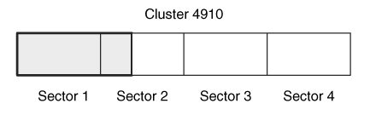
Metadata Analysis Techniques (cont’d)
Slack Space
Slack space occurs when the size of a file is not a multiple of a data unit size. A file must allocate a full data unit, even if it needs only a small part of it, and the unused bytes in the last data unit are called slack space.
For example, if a file is 100 bytes, it needs to allocate a full 2,048-byte data unit, and the final 1,948 bytes would be slack space.
Slack space is considered allocated data. It may contain hidden data
Slack space of a 612-byte file in a 2048-byte cluster.
Notes:
Next, we will introduce another important concept of slack space.
Slack space occurs when the size of a file is not a multiple of a data unit size. However, a file system allocates disk space in data units or clusters. Therefore, a file must be given a full data unit, even if it needs only a small part of it, and the unused bytes in the last data unit are called slack space.
In the example here, a file is 100 bytes in size, and the data unit size is 2,048 bytes. So it needs to allocate a full 2,048-byte data unit, and the final 1,948 bytes would be slack space.
Please note that slack space is considered allocated data. It may contain hidden data

Slide 63

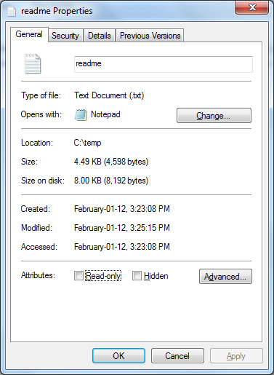
Notes:
If you have a chance to look at the properties of a file. You may notice there are two sizes for a file.
One is the file size, and another is the size on the disk for the file, which means how much disk space is occupied by the file. In most of the time, they are different, and the size on the disk is larger than the file size. The difference is the slack space.

Slide 64
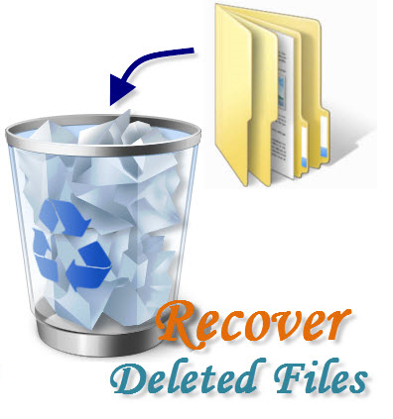
Dose of Reality:
Notes:
As mentioned, even we format a disk, we may still be able to recover the deleted files as far as they are not overwritten. Next, we will study techniques for recovering deleted data from a computer.

Slide 65
Metadata Analysis Techniques (cont’d)
- Unallocated Metadata Analysis
unallocated metadata entry
Hard disk image
Recover data/file
Notes:
When a file is deleted, we know that it isn’t really erased, and file content does not change, and remains intact until it is overwritten.
When a file is deleted, the associated Metadata entry also become unallocated. So we should analyze these unallocated Metadata entries and look for these deleted files so as to recover them.

Slide 66
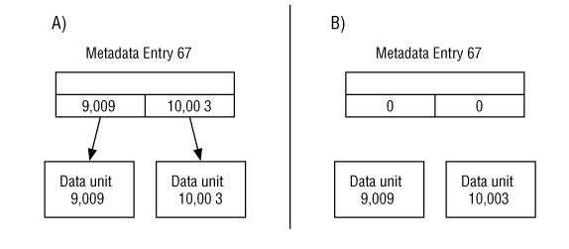

Metadata Analysis Techniques (cont’d)
- Metadata-based File Recovery
Two scenarios where in (A) the data unit pointers are not wiped when the entry is unallocated and in (B) they are wiped.
Notes:
Next, we take a look at Metadata-based File Recovery technique.
But there are some possibilities for the metadata associated with the deleted file.
First, the metadata associated with the deleted file still exist on your hard drive, and then it becomes very easy to recover the deleted file. It is also known as Metadata-based File Recovery.
[click]
Second, the metadata is wiped out. But, the file content remains intact. Then, it may become challenging to recover a deleted file. We will need another data recovery technique, called file carving, which will be detailed later.

Slide 67


Metadata Analysis Techniques (cont’d)
- Metadata-based File Recovery
Remain intact or unchanged
Data Area
File Deletion in FAT File Systems
Notes:
Let’s take a look at FAT file system as an example, a popular file system still widely used today in removable media.
When a file is deleted in a FAT file system, the first letter of the file name will be replaced by a special character (0xE5), indicating that this is a deleted file. Also, all the FAT table entries related to the deleted file or the data unit addresses are wiped out and filled with all zeros. But the file size as well as the address of the first data block (cluster) are still there, not removed. Therefore, it is very straightforward to recover deleted files by using remaining file metadata information.
This is also based on one fact that most of files are stored in contiguous space on a hard disk.
[click]
As such, we locate the begin of the file. Also, we know the file size. It is very easy to recover the deleted file.

Slide 68
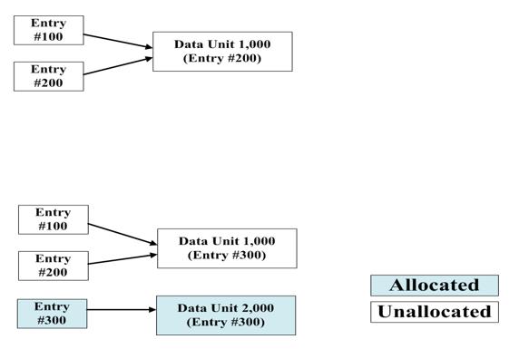

Metadata Analysis Techniques (cont’d)
- Metadata-based File Recovery
A
We need to figure out which of the Metadata entries allocates the data unit 1000 most recently.
File1
File2
B
File1
File2
File4
Entry
#300
File3
Notes:
However, even the metadata associated with the deleted file still exist on your hard drive, sometimes the situation could be very confusing and challenging. Let’s take a look at three different scenarios:
In Scenario A: suppose File 1 is created, using Metadata entry 100. Metadata entry 100 allocates data unit 1,000 and saves data to it. File 1 is then deleted, and both entry 100 and data unit 1,000 become unallocated. A new file, File 2, is created in metadata entry 200, and it reallocates data unit 1,000. Later, that File 2 is also deleted. If we analyzed this system, we would find two unallocated metadata entries that have the same data unit address. So the question is: which file, File 1 or File 2 can be recovered?
[click]
We need to determine which of the Metadata entries allocated the file most recently. In the example here, we know it is File 2, which can be recovered. But unfortunately, we will not know it if you only have two deleted metadata information. This is because we simply don’t know metadata allocation behavior in an OS using the file system. Please note that for many Operating Systems, such as Windows, Linux, there is no published detailed specification that describes how data unit allocation (disk space allocation) works or behaves in these Oses.
In Scenario B: Similarly, suppose File 1 is created, using Metadata entry #100. Metadata entry #100 allocates data unit 1,000 and saves data to it. File 1 is then deleted, and both entry #100 and data unit 1,000 become unallocated. A new file, File 2, is created in metadata entry #200, and it reallocates data unit 1,000. Later, that File 2 is also deleted.
Afterwards, a new file was created, using Metadata entry #300. Metadata entry #300 allocates data unit 1,000 after it was unallocated by entry #200.
The file is then deleted, and both entry #300 and data unit 1,000 become unallocated.
[click]
Next, File 4 was created and entry 300 was reallocated for it with a new data unit, data unit 2,000.
So the same question is here: which file, File 1 or File 2 can be recovered?
The answer is none of them!
[click]
This is because is that even if an unallocated metadata structure still contains the data unit addresses, for example, both unallocated metadata entries, entry #100 and entry #200 contains the data unit address 1,000 (the same data unit address). But, the evidence only tells us that Metadata entries #100 and #200 have allocated data unit 1,000, but we don't know which Metadata entry is the last one that allocated the data unit.
In the example here, neither Metadata entries #100 or #200 is the last Metadata entry allocated the data unit.
So the content in the data unit 1,000 doesn't belong to any file, File 1 or File 2. Of course, both File 1 and File 2 cannot be recovered.
From the examples here, you can see that even if we recover some data, we may not know which file the recovered data belongs to.

Slide 69


Metadata Analysis Techniques (cont’d)
- Metadata-based File Recovery
Typically, the contents of deleted files are not removed immediately from the drive, and these deleted files' data that has not been overwritten can be recovered. However, there is little chance of recovery for recovering overwritten files.
We can recover deleted files.
Notes:
So how can we know whether or not we are able to recover a deleted file. Typically, the contents of deleted files are not removed immediately from the drive, and these deleted files' data that has not been overwritten can be recovered.
[click]
So it is possible to recover deleted files.

Slide 70

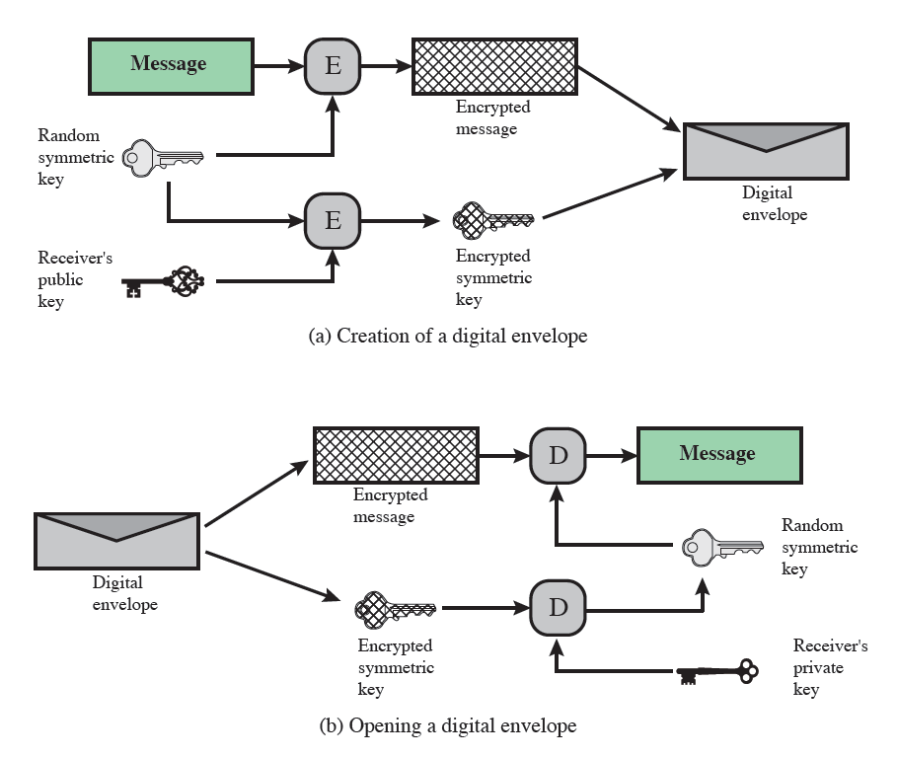
Cryptography - Digital Envelopes
Encrypted Files
Notes:
Unfortunately, sometimes the deleted files are encrypted. It could be very challenging to recover these deleted encrypted files.
So we will first review some cryptographic technique, digital envelope, using a combination of Symmetric-key encryption and asymmetric key encryption.
A digital envelope is a secure electronic data container that is used to protect a message by combining Symmetric-key encryption and asymmetric key encryption. As such, a digital envelope allows users to encrypt data with the speed of secret key encryption and the convenience and security of public key encryption.
Specifically, suppose a user wants to send a secret message to someone else. So the sender first randomly picks up a secret key (or a symmetric key) and then uses the receiver’s public key to encrypt the randomly chosen key k. Afterwards, the sender uses the randomly chosen secret key to encrypt the message. Afterwards, the sender put together the encrypted secret key as well as the encrypted message (It is akin to putting them into an envelope) and forward it in a whole to the receiver.
Upon receipt of the digital envelope, the receiver can use his or her private key to decrypt the protected symmetric key and get the secret key randomly chosen by the sender. Then, the receiver can use the obtained symmetric key to decrypt the protected message.

Slide 71
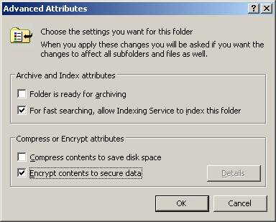
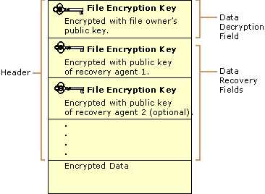
Metadata Analysis Techniques (cont’d)
- Encrypted File Recovery
For example, The NTFS Encrypting File System (EFS) uses hybrid encryption : first, the file contents is encrypted with a random symmetric key, then this symmetric key is encrypted with the public keys of each of the users allowed to decrypt the file (RSA public key encryptions).
[1] Xiaodong Lin, Chenxi Zhang and Theodora Dule. On Achieving Encrypted File Recovery. E-Forensics 2010), Shanghai, China, 2010.
Notes:
The hybrid encryption technique used in Digital Envelope is also adopted for file encryption. For example, the NTFS Encrypting File System (EFS) uses hybrid encryption : first, the file contents is encrypted with a random symmetric key, then this symmetric key is encrypted with the public keys of each of the users allowed to decrypt the file (RSA public key encryptions). Therefore, we will also need to further figure out the file encryption key protected by the public key of an authorized user as well as the encryption algorithm used to encrypt the file.

Slide 72
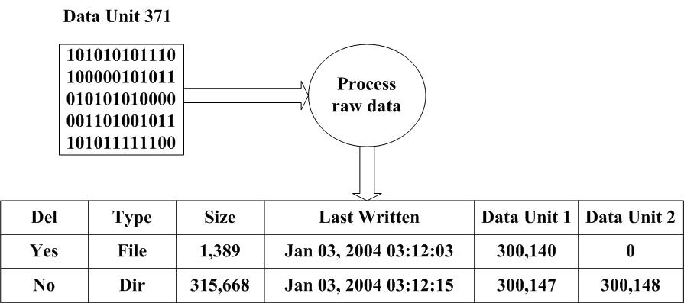
Metadata Analysis Techniques (cont’d)
- Metadata Lookup
Contains two metadata entries
The investigator knows the file
Process for viewing the contents of a metadata entry.
Notes:
In many cases, we analyze metadata because we know the name of a file that points to a
specific metadata structure and we want to learn more about the file.
We, therefore, need to locate the metadata entry representing the file.
Specifically we sift through the file names and find the metadata entry pointed by the name of the file we are interested in.
What is inside a metadata structure?
Then, it includes location of file content or the addresses of data units allocated to the file, and MAC times.
By processing its data structure, we know what its contents are and when it was created.

Slide 73
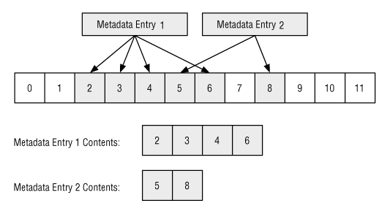
Metadata Analysis Techniques (cont’d)
- Logical File Viewing
We can combine the information from the metadata entries and the data units to view the file content.
Notes:
After we know the location of file content or the addresses of data units allocated to the file. So we can view the file content.

Slide 74
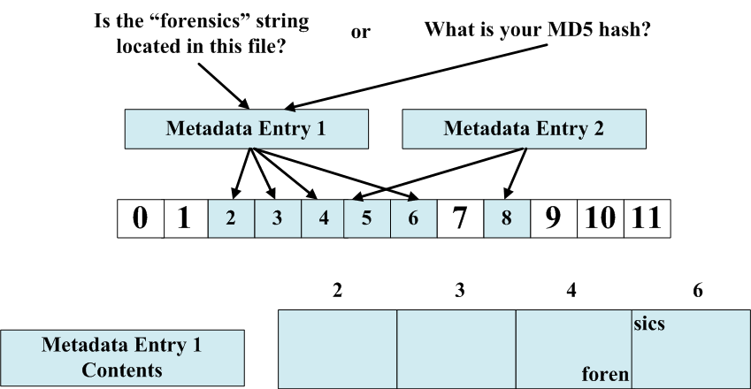
Metadata Analysis Techniques (cont’d)
- Logical File Searching
A logical file search looks into the data units allocated to a metadata entry.
Notes:
After we are able to gain access the file content, we can search the files.
Two possible ways. For example, search for some keywords within a file. In the example here, we want to know if the “forensics” string is contained in the file represented by the Metadata Entry 1.
Or, we could search for known files in the suspect’s computer by some given MD5 hash. It is also known as File Signature Search.

Slide 75

Metadata Analysis Techniques (cont’d)
- File Signature Search
The NIST National Software Reference Library (NSRL) contains hashes of files that are found in operating systems and software distributions. These files are known to be good in that they came from trusted sources and are typically on authorized systems.
The NSRL must be obtained from NIST at www.nsrl.nist.gov.
Database
Ignore Database
Alert Database
[1] Hash Database Help. http://www.sleuthkit.org/autopsy/help/hash_db.html
Notes:
Next, we take a look at a widely used File Signature Search approach by The National Institute of Standards and Technology (NIST). NIST has created National Software Reference Library (NSRL), which a hash database of known files, which could be good files, such as Windows system files, or bad files, for example, malware.
The hash database of known good files is called Ignore Database,
The hash database of known bad files is called Alert Database

Slide 76

Metadata Analysis Techniques (cont’d)
- File Signature Search
The NIST National Software Reference Library (NSRL)
Hash values
Ignore Database
Hash values
Alert Database
Notes:
Typically, The National Institute of Standards and Technology (NIST) collected a lot of files,
including good files, such as Windows system files, and bad files, for example, malware.
Then, they calculate the hash values of these collected files. Specially, they insert the hash values of these good files into a hash database called Ignore Database, and the hash values of these bad files into a hash database called Alert Database.

Slide 77
Metadata Analysis Techniques (cont’d)
- Metadata Attribute Searching and Sorting
Notes:
Another popular analysis techniques for Metadata is Metadata Attribute Searching and Sorting.

Slide 78
MAC Times
Notes:
Recall that the metadata includes three important timestamps including modification time (written), and accessed time and creation time. It is also known as MAC Times.

Slide 79
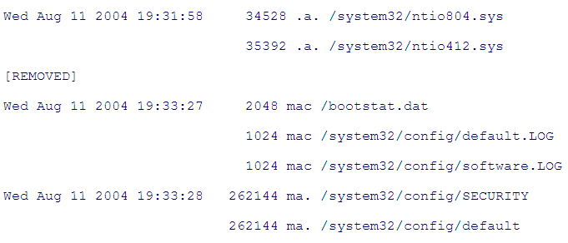
Metadata Analysis Techniques (cont’d)
- Metadata Attribute Searching and Sorting
An example of the mactime output for the C:\Windows directory
Notes:
So we can arrange the Metadata entries in the order in which they happened. So we may know what exactly happened to a system. It is also known as Timeline Analysis.

Slide 80
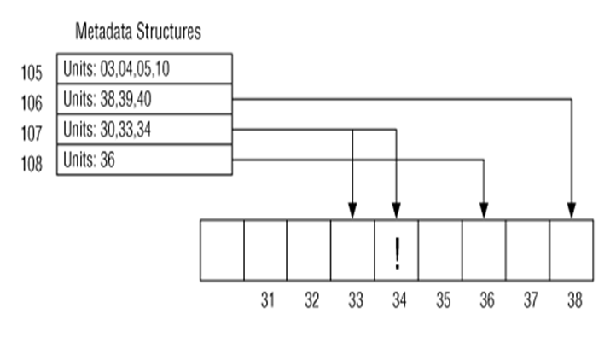
Metadata Analysis Techniques (cont’d)
- Metadata Attribute Searching and Sorting
The investigator is interested in this data
30
It can be useful to search the metadata structures to find one that has allocated a given data unit.
Notes:
In some cases, the investigator may find some data which is interested to him or her in a particular data unit. So the investigator can search the metadata structures to find which metadata allocates the given data unit.
In other words, the investigator also wants to know which file occupies the given data unit and contains the keyword or data.

Slide 81
Metadata Analysis Techniques (cont’d)
- Data Structure Allocation Order
Metadata Allocation Order: Metadata allocation behavior affects the accuracy and success of deleted file recovery.
want to figure out the allocation order of two metadata entries
Depends on the allocation strategy of the OS
Notes:
As mentioned before, metadata allocation behavior affects the accuracy and success of deleted file recovery. So it would better if we know the allocation order of two metadata entries. It depends on the allocation strategy of the OS.
Also, we should do a consistency check on metadata structures, looking for some abnormalities. For example, two metadata entries allocate a same data unit.

Slide 82

Metadata Analysis Techniques (cont’d)
- Consistency Checks
Consistency Checks
Notes:
Also, we should do a consistency check on metadata structures, looking for some abnormalities. For example, two metadata entries allocate a same data unit.

Slide 83

File Name Category
Notes:
Next, we look at some analysis techniques that can be performed with data from the file
name category.

Slide 84
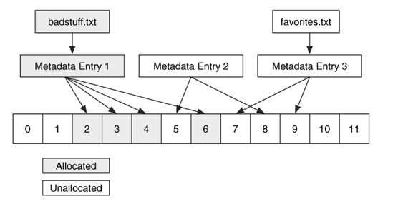
File Name Analysis Techniques (cont’d)
- File Name-based File Recovery
We can recover files based on their unallocated name, but we still rely on metadata-based recovery techniques.
Notes:
When a file is deleted, the associated file name data structure also become unallocated. So we could analyze these unallocated file name data and look for these deleted files so as to recover them. But, in reality, we still rely on metadata-based recovery techniques.
In other words, we use the unallocated file name data to find unallocated metadata entry. Afterwards, we can simply use Metadata-based File Recovery technique introduced before to recover the deleted file.

Slide 85
File Name Analysis Techniques (cont’d)
- File Name-based File Recovery
Remain intact or unchanged
Remaining file name
Data Area
File Deletion in FAT File Systems
Notes:
Let’s take a look at FAT file system as an example again.
When a file is deleted in a FAT file system, the first letter of the file name will be replaced by a special character (0xE5), indicating that this is a deleted file. Also, all the FAT table entries related to the deleted file or the data unit addresses are wiped out and filled with all zeros. But the file size as well as the address of the first data block (cluster) are still there, not removed. Therefore, it is very straightforward to recover deleted files by using remaining file metadata information.
This is also based on one fact that most of files are stored in contiguous space on a hard disk.
[click]
As such, we locate the begin of the file. Also, we know the file size. It is very easy to recover the deleted file.

Slide 86

Deleted or Lost File Recovery
We can recover deleted files as long as these deleted files' data has not been overwritten.
Notes:
The principle for data recovery is that we can recover deleted files as long as these deleted files' data has not been overwritten.

Slide 87
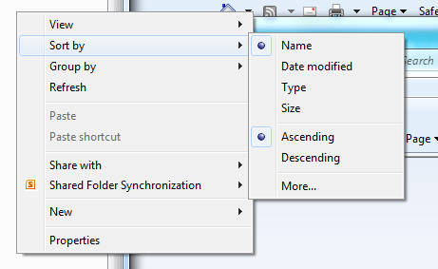
File Name Analysis Techniques (cont’d)
- File Name Listing
Notes:
One of the most common investigation techniques for file name data is to list the names of the
files and directories. We do it every day.

Slide 88

1
2
3
Notes:
What happened?
Recall the relationship among these five data categories in file system, particularly, File Name, Metadata, and Content data.
After you know the file name, you can find the corresponding metadata which is used to describe the file, including the
addresses of the clusters/blocks that store the file contents.
Based on the addresses of data units occupied by the file, you can locate the file contents.

Slide 89
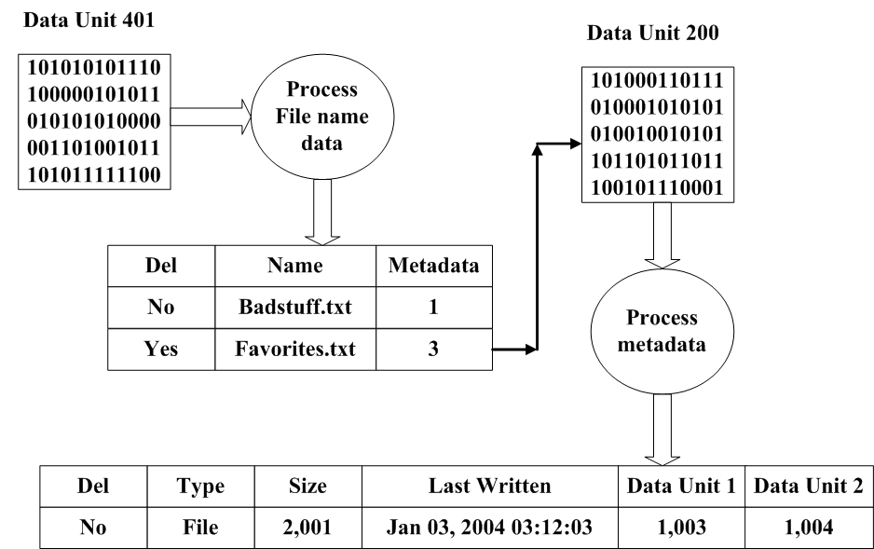
File Name Analysis Techniques (cont’d)
- File Name Listing
We view file names by processing a data unit and listing the names and sometimes the metadata associated with it.
Notes:
So we can view file names by investigating the disk space containing the file name data structures and processing the file name structures.
Then, we also can go further and view the metadata associated with the file name.
In other words, to locate a file, metadata is still very critical information for us investigating the file.

Slide 90

File Name Analysis Techniques (cont’d)
- File Name Searching
Find files in Linux using 'find'
find / -name readme.txt -print
Notes:
Actually, many OSes provide file search function based on file name. In the example here, you search for a file named readme.txt from the root folder in Linux.
What happened? The find utility sift through the file name data and process the data structure, looking for one file name matching “readme.txt”.

Slide 91
File Name Analysis Techniques (cont’d)
- Data Structure Allocation Order
File Name Allocation Order: File Name allocation behavior affects other digital forensic tasks, for example, which can be used to find the relative creation time of two names.
want to figure out the allocation order of two file name data structures
Depends on the allocation strategy of the OS
Notes:
As we already discussed with content and metadata, different OSes also behave differently when allocating file name Structures. But knowing the allocation order of file name structures is very important, which can be used to find the relative creation time of two names.

Slide 92

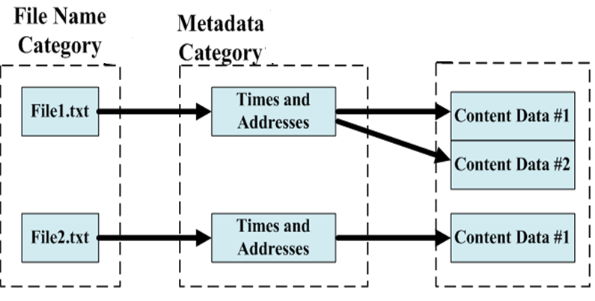
File Name Analysis Techniques (cont’d)
- Consistency Checks
Consistency Checks
Notes:
Also, we should do a consistency check on file name structures, looking for some abnormalities. For example, an allocated file name structure, but doesn’t have any associated Metadata entry.

Slide 93

Application Category
Notes:
We next look at some analysis techniques of Application category, which provides special features such as user quota information and file system journals.

Slide 94
File System Journal Analysis
A file system in which the hard disk maintains data integrity in the event of a system crash or if the system is otherwise halted abnormally.
The journaled file system (JFS) maintains a log, or journal, of what activity has taken place in the main data areas of the disk; if a crash occurs, any lost data can be recreated because updates to the metadata in directories and bit maps have been written to a serial log.
The JFS not only returns the data to the pre-crash configuration but also recovers unsaved data and stores it in the location it would have been stored in if the system had not been unexpectedly interrupted.
It is widely believed that File system journals are useful in digital investigations, but not being fully utilized today.
[1] journaled file system.
http://www.webopedia.com/TERM/J/journaled_file_system.html
[2] Swenson C., Phillips R., Shenoi S. File System Journal Forensics. IFIP - Advances in Digital Forensics, 2007
[3] Kevin D. Fairbanks, An analysis of Ext4 for digital forensics, DFRWS 2012
Notes:
Recall that the journal is a special file that logs the changes destined for the file system. Note that the journal is in the application category because it is not needed for the file system to operate. It exists to make your system more robust and reliable, which can be easily recovered if your computer crashes.
File system journals may turn out to be useful in investigations, although to date they have not been fully utilized. A journal shows which file system events recently occurred, and this could help with event reconstruction of a recent incident.

Slide 95
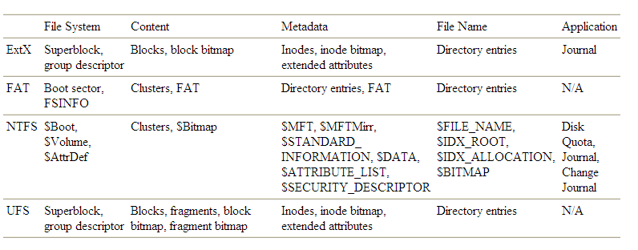
Specific File Systems
Focusing on the most common file systems encountered in forensics for Windows (FAT and NTFS).
The data structures in each data category for some file systems
Notes:
There are too many file systems available today. The table here lists some popular ones with the data structures in each data category for them.
[click]
In this course, we will be focusing on the most common file systems encountered in forensics for Windows including FAT and NTFS.

Slide 96
Analysis Roadmap
Volume Analysis (mmls)
File System Analysis Analysis (fsstat)
Keyword Searching
Hard disk image
File Signature Search
Recover Deleted file
Metadata
View data
Timeline Analysis
Deleted file search
Notes:
After data acquisition, you may create a forensic image from a compromised system or a system used by the suspect. Then, you can conduct a forensic analysis on the disk image using different analysis techniques, including Volume Analysis (for example using TSK tool mmls), File System Analysis Analysis (for example using TSK tool fsstat), Keyword Searching, File Signature Search, Timeline Analysis. Or, you can display or view data.
Also, you should pay more attention to Metadata, which is generally invisible to regular users. But it contains some important information about files. By looking at these unallocated Metadata entries, you can find deleted files and then recovered these deleted ones.

Slide 97
Analysis Roadmap (cont’d)
Keyword Searching
Hard disk image
Unallocated data units
Recover Deleted file
Unpartitioned/damaged data units
View data
Hidden data check
Notes:
During a digital investigation, the investigators usually pay more attention to these unpartitioned/”labelled damaged” data units and unallocated data units. This is because it is very often that criminals try to hide their wrongdoings by deleting digital evidences or hiding data. Therefore, these unpartitioned disk space could be used to hide data, and these ”labelled damaged” data units may not be really damaged so we can view the content if there is any suspicious.
Also, the investigators pay more attention to unallocated data units, for example, searching keywords in the unallocated disk space, viewing data in unallocated data units, and recovering deleted files.

Slide 98
Analysis Roadmap (cont’d)
Forensic Reporting
In order to keep a track record of every step of the investigation, document every procedural step. Evidence presented without proper documentation may not be admissible in court.
This documentation should not only include the recovered files and data, but also the physical layout of the system along with any encrypted or reconstructed data.
Forensic analysis of time-based metadata (timeline analysis) can help investigators correlate distinct information quickly and to find notable time and dates of activities related to improper computer usage, spoliation and misappropriation.
[1] Computer Forensics: Media & File System Forensics
https://resources.infosecinstitute.com/category/computerforensics/introduction/areas-of-study/digital-forensics/media-file-system-forensics/#gref
Notes:
Finally, I want to talk about the importance of Forensic Reporting.
You must document every procedural step. Evidence presented without proper documentation may not be accepted in court.
Forensic analysis of time-based metadata (timeline analysis) can help investigators correlate distinct information quickly and to find notable time and dates of activities related to computer abuse.

Slide 99

Reading materials
Chapter 5
Computer Forensics: Media & File System Forensics
https://resources.infosecinstitute.com/category/computerforensics/introduction/areas-of-study/digital-forensics/media-file-system-forensics/#gref
An Introduction To Computer Forensics
https://resources.infosecinstitute.com/category/computerforensics/introduction/
Derek Bem, Francine Feld, Ewa Huebner, Oscar Bem. Computer Forensics - Past, Present and Future
http://www.cis.gsu.edu/rbaskerville/cis8630/Bernetal2008.pdf

